Slide 1

Data Science Committee
Session 07 – Machine Learning Overview
Prepared by: Ashraf Abdulkhaliq

Slide 2
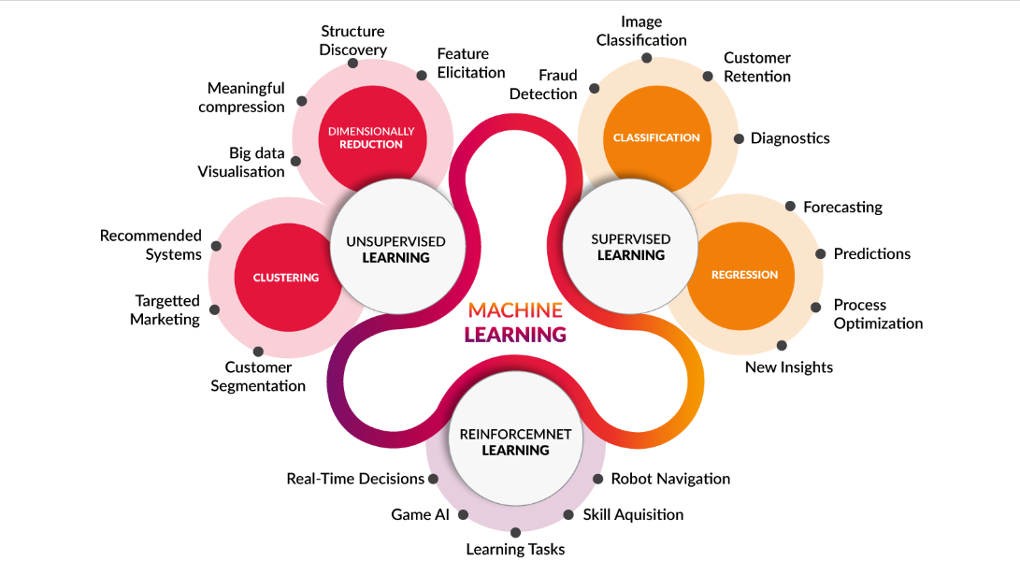
Introduction

Slide 3
Outline
What is Machine Learning
ML Algorithms Overview
Performance Measure

Slide 4
Outline
What is Machine Learning
ML Algorithms Overview
Performance Measure

Slide 5
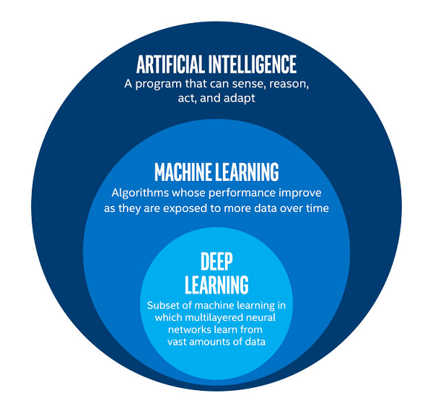
What is Machine Learning
Machine learning is a branch of artificial intelligence, a science that researches machines to acquire new knowledge and new skills and to identify existing knowledge.

Slide 6
Outline
What is Machine Learning
ML Algorithms Overview
Performance Measure

Slide 7
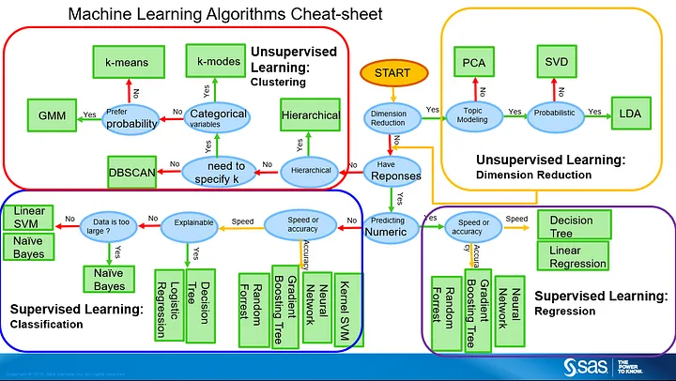
ML Algorithms Overview

Slide 8
Aspect | Distance-Based Algorithms | Probability-Based Algorithms | Tree-Based Algorithms
Nature of Output | Regression and Classification | Regression and Classification | Regression and Classification
Decision Making | Decides based on how close things are in points | Decides based on likelihoods or chances/probability | Decides by following a tree-like structure
Example Algorithms | k-Nearest Neighbors (KNN) | Naive Bayes | Decision Trees, Random Forest, XGBoost
Training Time | Can be quick for small amounts of data | Can be quick for small amounts of data | Depends on the complexity of the tree and data size
Scalability | Can be slow for lots of data | Usually handles lots of data well | Generally good, especially when using many trees
Handling Outliers | Can be influenced by unusual data points | Not easily swayed by unusual data points | Can be affected by outliers in the data
Interpretability | Can be a bit tricky to understand | Usually makes sense to people | Kind of makes sense, but not always straightforward
Parameter Sensitivity | Can be picky about settings like how many neighbors to consider | Can be sensitive to assumptions about data | Sensitive to settings like tree depth and complexity
Handling Missing Values | Sometimes needs extra care with missing information | Generally okay with missing data | Can handle missing info to some extent

Slide 9
Outline
What is Machine Learning
ML Algorithms Overview
Performance Measure

Slide 10
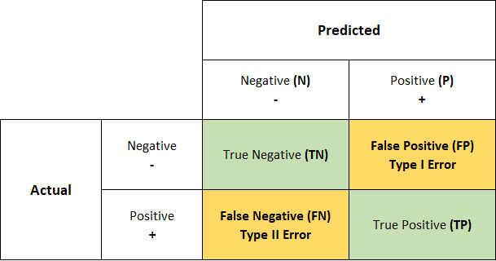
Confusion Matrix

Slide 11
References
https://medium.com/ml-research-lab/machine-learning-algorithm-overview-5816a2e6303
https://www.anandtech.com/show/12673/titan-v-deep-learning-deep-dive/2

Slide 12
Thanks
Please keep updated:
https://github.com/kershrita/Data-Science-Roadmap

